Slide 1
Transport across cell membranes

Slide 2
Walls and membranes
The plant cell wall is completely permeable. It does not control what enters the cell
Cell membranes are semi-permeable. They allow some small molecules to move through them but not large ones.

Slide 3
Passive transport
Diffusion
This is the net movement of particles in a gas or liquid from an area of high concentration to an area of low concentration
It occurs because particles are constantly moving and will spread out until they are evenly spread out
It does not need any more energy than is normally present in the environment

Slide 4
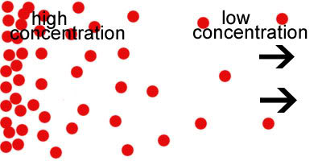
Diffusion cont’d
Diffusion occurs along a concentration gradient.
The gradient refers to the fact there is more of the substance at one end and less at the other

Slide 5
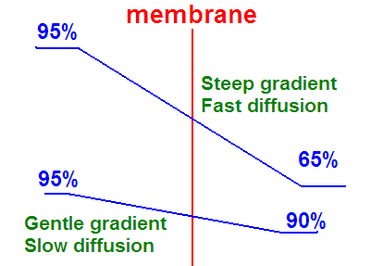
Diffusion cont’d
Rate of diffusion depends on:
Size of particles – smaller move faster
Temperature – warmer, faster
State of matter – gases faster than liquids
Concentration of particles – steeper gradient, faster diffusion

Slide 6
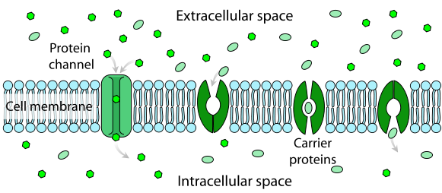
Facilitated diffusion
Transport proteins in the cell membrane help certain particles diffuse through them
E.g. glucose & oxygen

Slide 7
Osmosis
Osmosis is the diffusion of water molecules across a semi-permeable membrane from an area of higher water concentration to an area of lower water concentration.
(NOTE: higher water concentration means it is more pure. Lower water concentration means it has more salt, sugar or other particles dissolved in it)

Slide 8
Osmoregulation
If one cell has a 5% sugar concentration and another has a 10% sugar concentration, the 5% one has more water in it.
A strong solution with higher sugar concentration is said to be hypertonic
A weak solution with lower sugar concentration is said to be hypotonic
Solutions with the same concentration are said to be isotonic

Slide 9
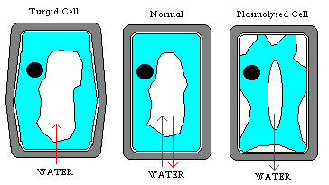
A plant cell placed in a hypotonic solution will absorb water and become turgid
Animal cells will actually burst.
Plant cells placed in hypertonic solutions lose water and become flaccid. If they lose too much water, the cell shrinks away from the cell wall and becomes plasmolysed

Slide 10
Osmoregulation in Animals
Water continually diffuses into Paramecium and amoeba. They use contractile vacuoles to pump it out
Freshwater fish urinate excess water often
Some marine animals (sharks and many invertebrates) keep their blood isotonic with seawater
Bony fish lose water to the sea so drink lots and excrete salt.

Slide 11
ACTIVE TRANSPORT
Movement of substances from an area of lower concentration to an area of higher concentration – against the concentration gradient
High
Concentration
Passive transport
With the concentration gradient (downhill)
Low Concentration
High Concentration
Low
Concentration
Active transport
Against the concentration gradient (uphill)

Slide 12
ACTIVE TRANSPORT Cont’d
Uses energy – mitochondria needed
Glucose used up
Oxygen used up
CO₂ produced
Heat produced

Slide 13
ACTIVE TRANSPORT Cont’d
Endocytosis = inward transport
Phagocytosis – cell ‘eats’ solid particles e.g. amoeba surrounds bacterium and takes it into a vacuole
Pinocytosis – cell ‘drinks’ a liquid droplet into a depression in its membrane then forms a vacuole
Exocytosis = outward transport
Reverse of above – vacuole fuses with cell membrane, opens, expels contents (e.g. enzymes)

